Slide 1


Automata Theory NFA,DFA, MATHEMATICAL INDUCTION
CSA1305
Theory Of Computation
Presented by: V . V.Dharanireddy(192311219)
Under the Guidance of :
Dr . Bala Manigandhan

Slide 2
Introduction
Automata Theory is a branch of theoretical computer science that studies abstract machines and the computational problems they can solve. It forms the foundation of compiler design, artificial intelligence, lexical analysis, pattern matching, and digital circuit design. Finite Automata are mathematical models used to recognize patterns and process input strings efficiently.

Slide 3
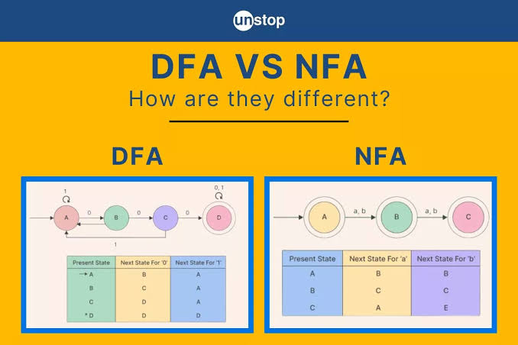

Slide 4
Objectives
Understand the concept of Finite Automata.
Study Deterministic and Non-Deterministic Finite Automata.
Learn the conversion of NFA to DFA.
Understand ε-transitions and ε-closure.
Apply Mathematical Induction to prove properties.
Explore real-world applications of automata.

Slide 5
Proposed System
The proposed system combines the concepts of DFA, NFA, ε-NFA, and Mathematical Induction into a unified approach. It demonstrates the conversion techniques, proofs, and practical applications using examples, making Automata Theory easier to understand and implement.

Slide 6
Advantages
Simple computation model
Faster pattern recognition
Easy compiler implementation
Reduces ambiguity
Improves computational efficiency
Strong mathematical foundation
Widely used in software development

Slide 7
Technologies used
Theory of Computation
Finite Automata
DFA
NFA
ε-NFA
Mathematical Induction
State Transition Diagrams
Transition Tables

Slide 8
Module 1 Module 1: NFA to DFA Conversion
NFA (Non-Deterministic Finite Automaton) allows multiple possible next states for a given input.
A DFA (Deterministic Finite Automaton) has exactly one next state for each input symbol.
Every NFA can be converted into an equivalent DFA without changing
The Subset Construction Method is used to perform the conversion.
Each DFA state represents a set of NFA states.
Real-life Example: ATM transaction validation follows deterministic steps from card insertion to cash withdrawal.

Slide 9
Module 2 Mathematical Induction
Mathematical induction is a proof technique used to verify statements for all positive integers.
It consists of two main steps: Base Case and Induction Step.
The base case verifies that the statement is true for the initial value.
The induction hypothesis assumes the statement is true for a particular value of n.
The induction step proves the statement is true for n+1.
It is widely used to prove properties of strings, languages, and recursive algo
Real-life Example: Proving formulas for the total number of objects arranged in rows.

Slide 10
Module 3 ε-NFA to NFA Conversion
These transitions are called epsilon (ε) transitions.
The ε-closure of a state includes all states reachable using only ε-transitions.
ε-transitions are removed to obtain an equivalent NFA.
The conversion preserves the language accepted by the automaton.
Final states are updated based on ε-closures.
Removing ε-transitions simplifies automata implementation.
ε-NFA to NFA conversion improves computational efficiency.
Real-life Example: Online shopping checkout where optional steps can be skipped.

Slide 11
Module 4 ε-NFA to DFA Construction
ε-NFA can be directly converted into an equivalent DFA.
The conversion begins by computing the ε-closure of the initial state.
Subset construction is applied using ε-closures.
The DFA accepts the same language as the original ε-NFA.
This conversion improves execution speed and simplifies implementation.
It is widely used in compiler design, lexical analyzers, and pattern matching.
Real-life Example: Traffic signal control system where each signal change follows a deterministic sequence.

Slide 12
Future Scope
AI-Based Automata Optimization: Use artificial intelligence to optimize state machines and improve computational efficiency.
Quantum Finite Automata: Explore quantum computing techniques to solve complex computational problems more efficiently.
Advanced Compiler Construction: Enhance compiler design with faster lexical analysis, parsing, and code optimization.
Cybersecurity Applications: Apply automata theory in intrusion detection, malware analysis, and secure protocol verification.
Natural Language Processing (NLP): Improve text processing, speech recognition, and language understanding using automata models.
Robotics Automation: Implement finite automata for robot navigation, decision-making, and autonomous control systems.

Slide 13
Conclusion
This presentation explained the concepts of DFA, NFA, ε-NFA, and Mathematical Induction. It demonstrated how different automata can be converted into equivalent models while preserving the accepted language. These concepts provide the theoretical foundation for modern computing systems, compiler design, pattern recognition, and artificial intelligence.

Slide 14
References
Hazard, E., & Kuperberg, D., Explorable Automata, Proceedings of the 31st EACSL Conference on Computer Science Logic (CSL 2023), Leibniz International Proceedings in Informatics (LIPIcs), 2023.
Qiu, D., Learning Quantum Finite Automata with Queries, Mathematical Structures in Computer Science, Cambridge University Press, 2023.
Rodrigues, N., Sebe, M. O., Chen, X., & Roșu, G., A Logical Treatment of Finite Automata, Tools and Algorithms for the Construction and Analysis of Systems (TACAS 2024), Springer, 2024.
Pighizzini, G., Prigioniero, L., & Sádovský, Š., Performing Regular Operations with 1-Limited Automata, Theory of Computing Systems, Vol. 68, 2024.
Salomaa, A., Salomaa, K., & Smith, T. J., Descriptional Complexity of Finite Automata – Selected Highlights, Fundamenta Informaticae, Vol. 191, 2024.

Slide 15
Thank You!

